Slide 2
CODE OF CONDUCT
AFGE is committed to providing an environment free from discrimination, bullying and harassment. As such, we do not tolerate discriminatory, harassing or otherwise unacceptable behavior at any of our activities, events or meetings. We expect everyone who participates in any of our activities, events or meetings to abide by the following Code of Conduct. This code of conduct does not apply to matters that are covered by the AFGE Constitution.

Slide 3
NEC VETERAN COMMITTEE
NVP Ottis Johnson (Chair), NVP Arnold Scott (Vice Chair), NVP Phil Glover (Past Chair), NVP David Gonzalez, NVP Tatishka Thomas, NVP Jason Anderson, NVP Diana Hicks

Slide 4
PURPOSE
AFGE Veterans brings union members, who are military veterans, together to speak out on the issues that impact veterans most. Those issues include the need for good jobs and a strong, fully funded and staffed VA. AFGE has the capacity to influence Congress, but only if union veterans are effectively organized and efficiently mobilized.

Slide 5
AGENDA:
AFGE Veterans Purpose
Building a Local Veteran Program
Veteran Recognition
AFGE Veteran of the Year
Habitat for Humanity Veterans Build
Veterans Merchandise
Question-Answer Session

Slide 6
3 key objectives of AFGE veterans
A-R-M our members for success:
ADVOCATE legislative/political issues
RECOGNIZE veterans in the Local
MENTOR veterans who are members

Slide 7
DISTRICT VETERAN COORDINATORS

Slide 8
VETERAN COORDINATOR VOLUNTEER JOB DESCRIPTION
Mentor other veterans
Recruit B.U. veterans to join Local
Tag all veterans in their AFGE profile and have veterans.
Sign up for AFGE Facebook Group
Join AFGE Veterans teleconferences
Unite veterans in legislative/political activity and organizing.
Volunteer for political elections
Encourage veterans to sign up for text alerts
Urge veterans to serve on their local VSO
Carry out annual veteran’s recognition event
VETERAN COORDINATOR TRAINING (TBD)

Slide 9
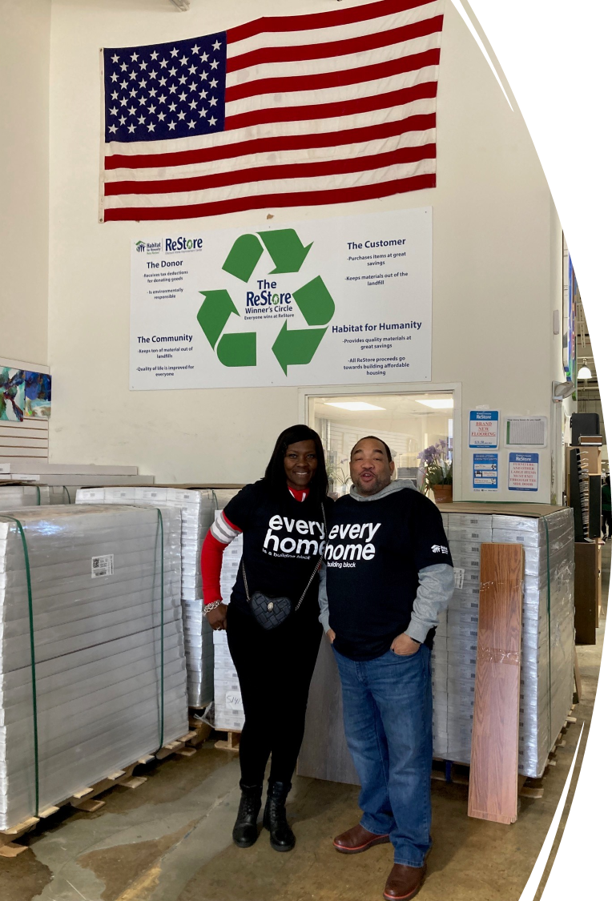
RESTORE (ROCKVILLE, MD)

Slide 10
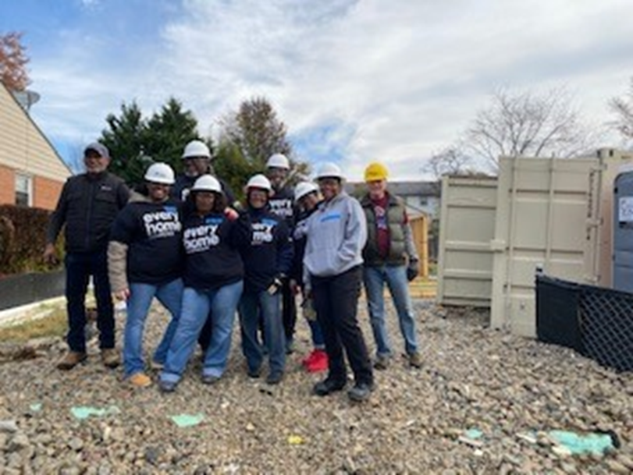
MARYLAND

Slide 11
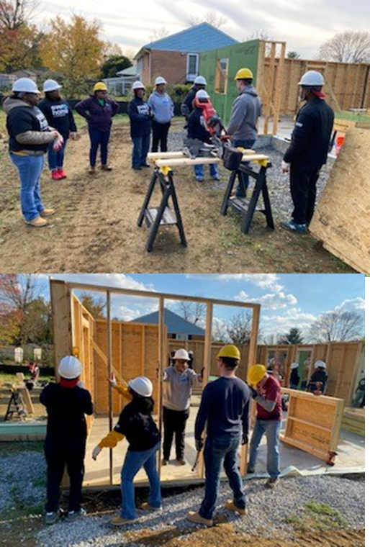
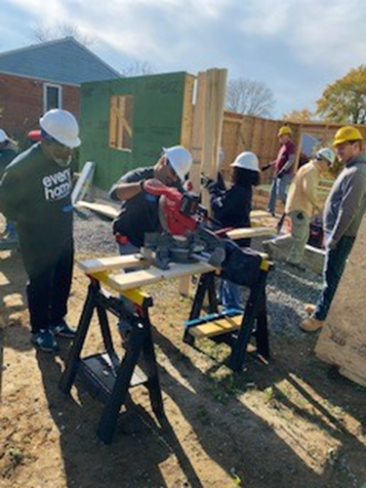
MARYLAND

Slide 12
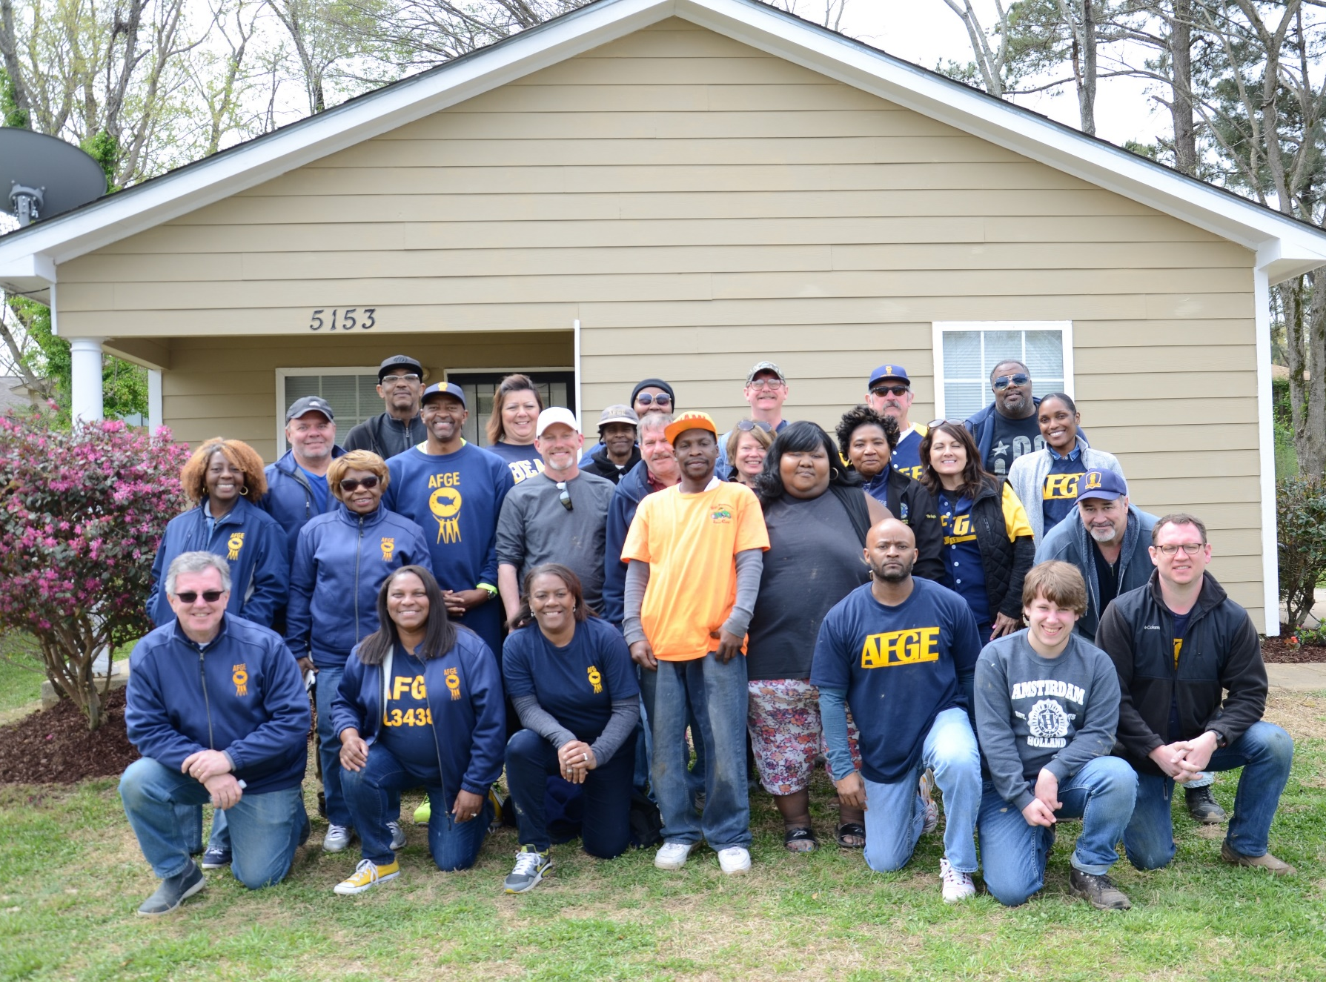
MEMPHIS, TN

Slide 13
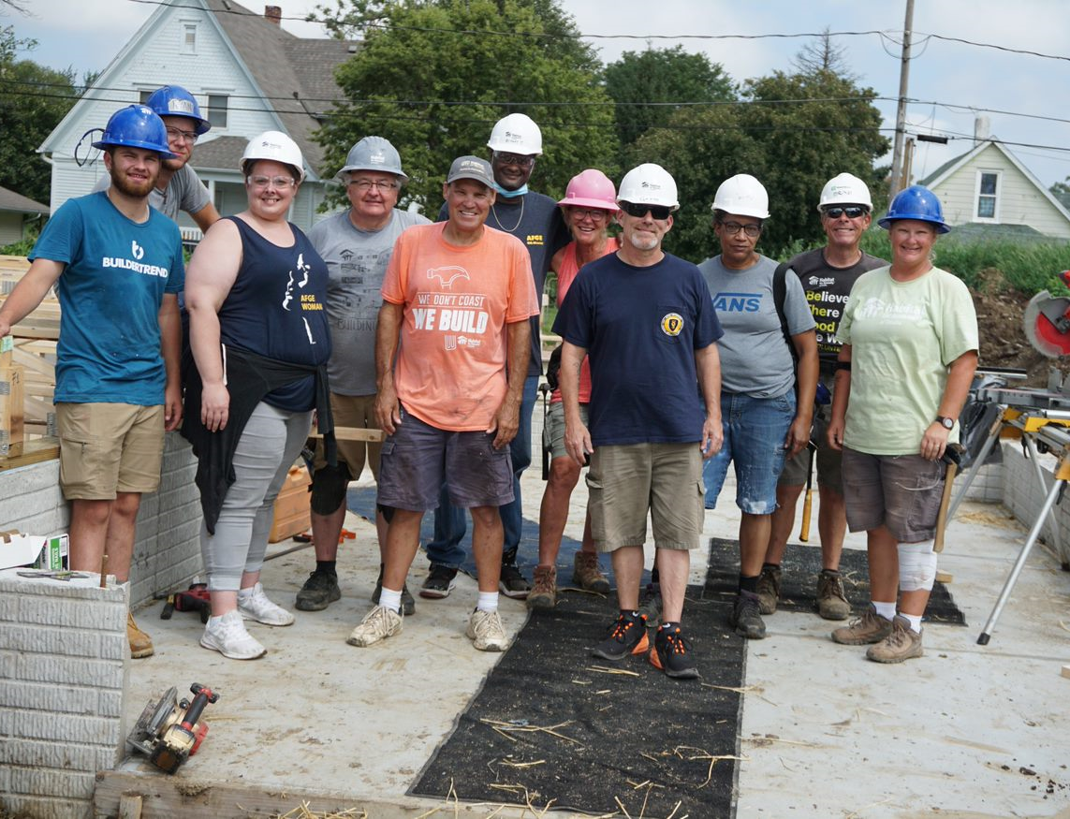
OMAHA, NE

Slide 14
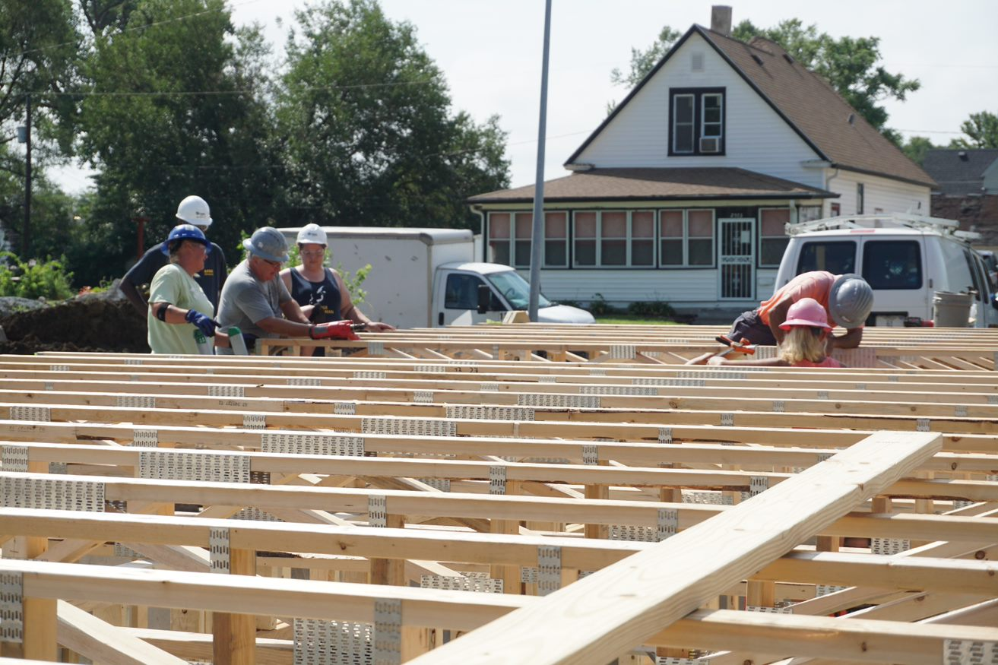
OMAHA, NE

Slide 15
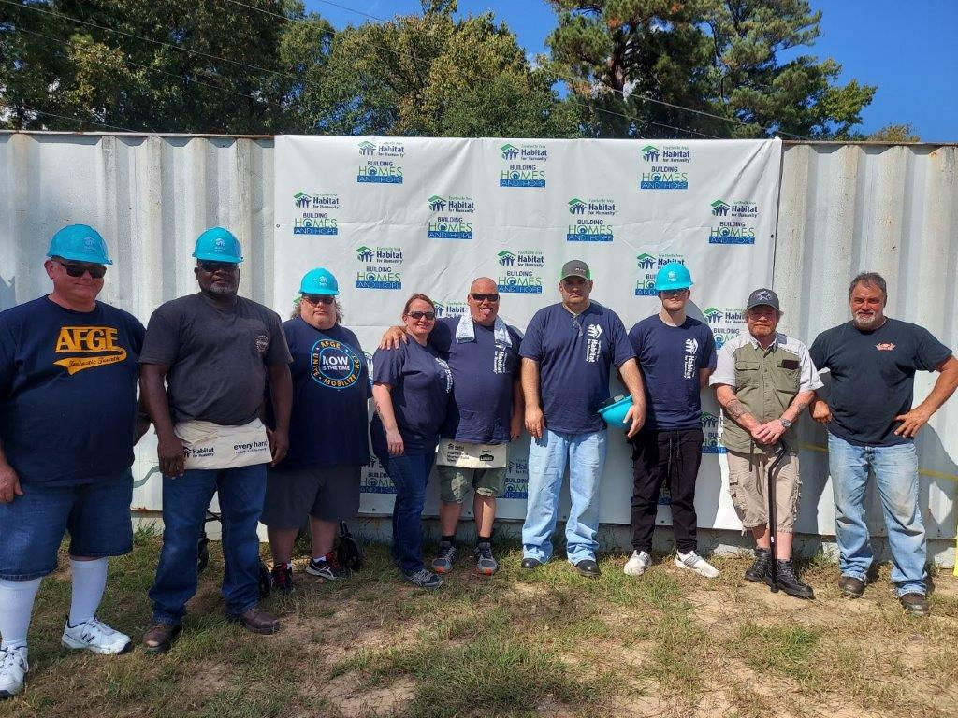
FAYETTEVILLE, NC

Slide 16
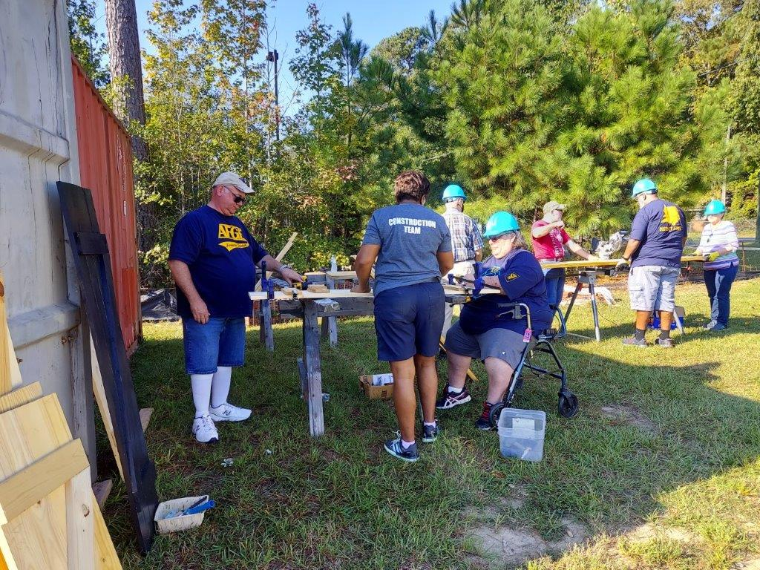
FAYETTEVILLE, NC

Slide 17
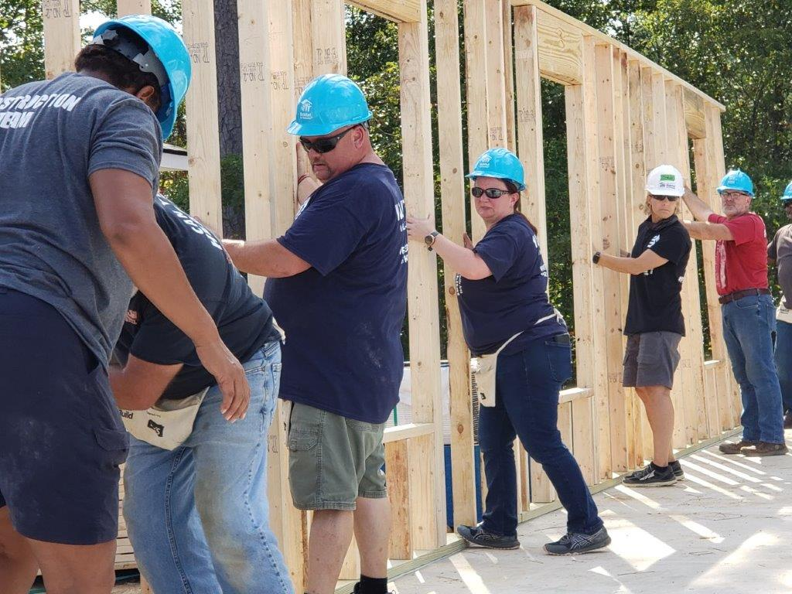
FAYETTEVILLE, NC

Slide 18
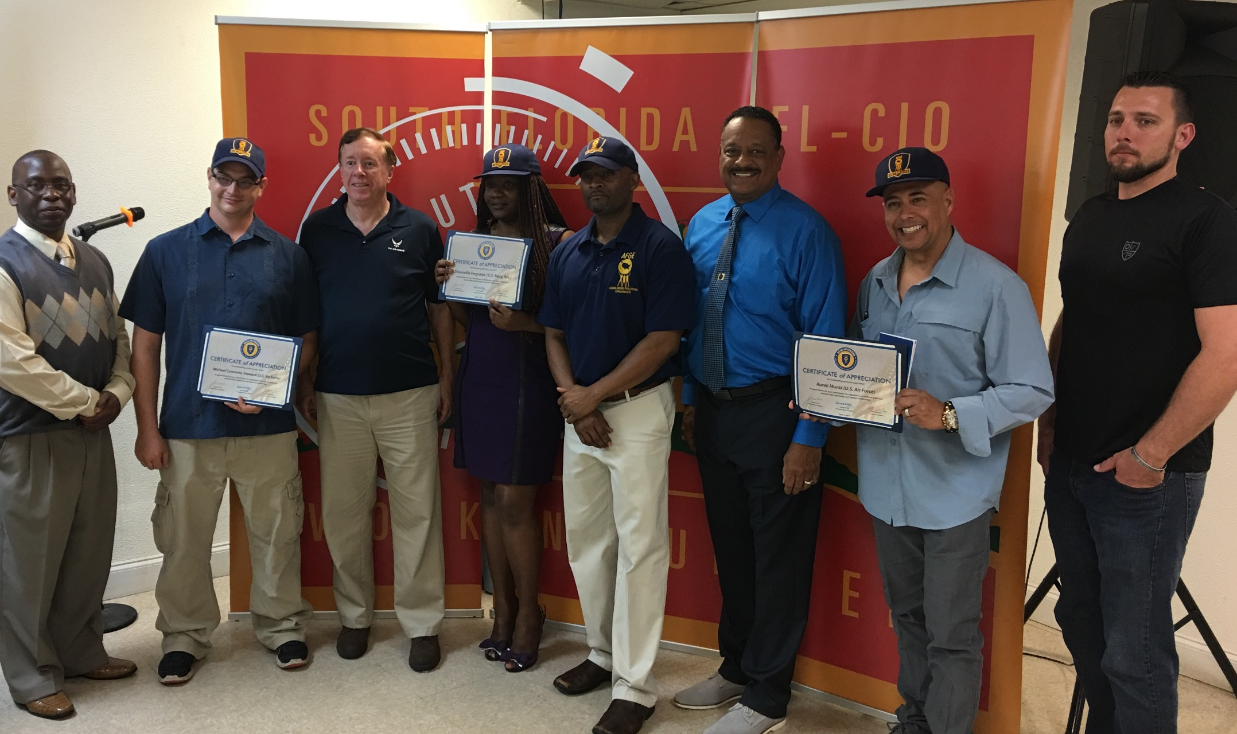
VETERAN APPRECIATION EVENT (MIAMI, FL)

Slide 19
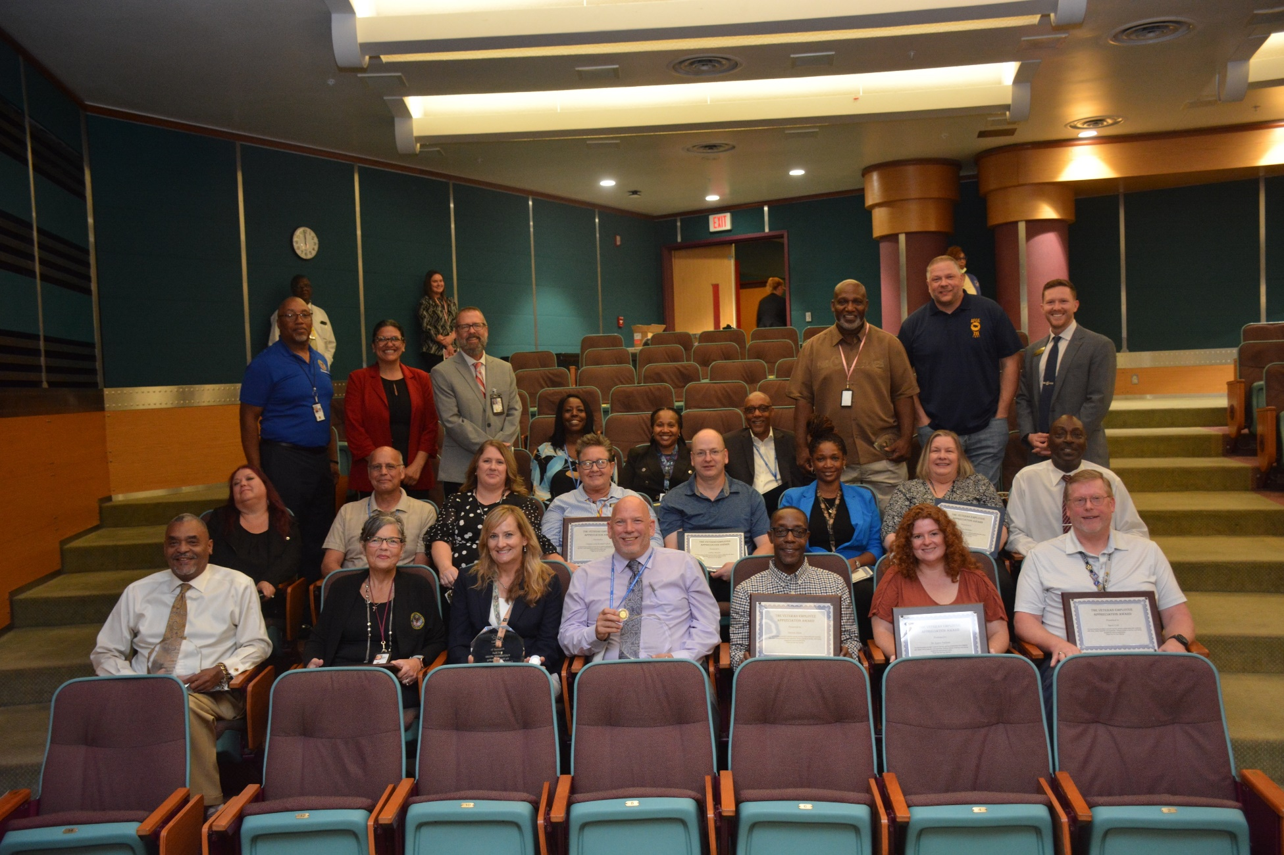
VETERAN APPRECIATION EVENT (Dingell VA – Detroit, MI)

Slide 20
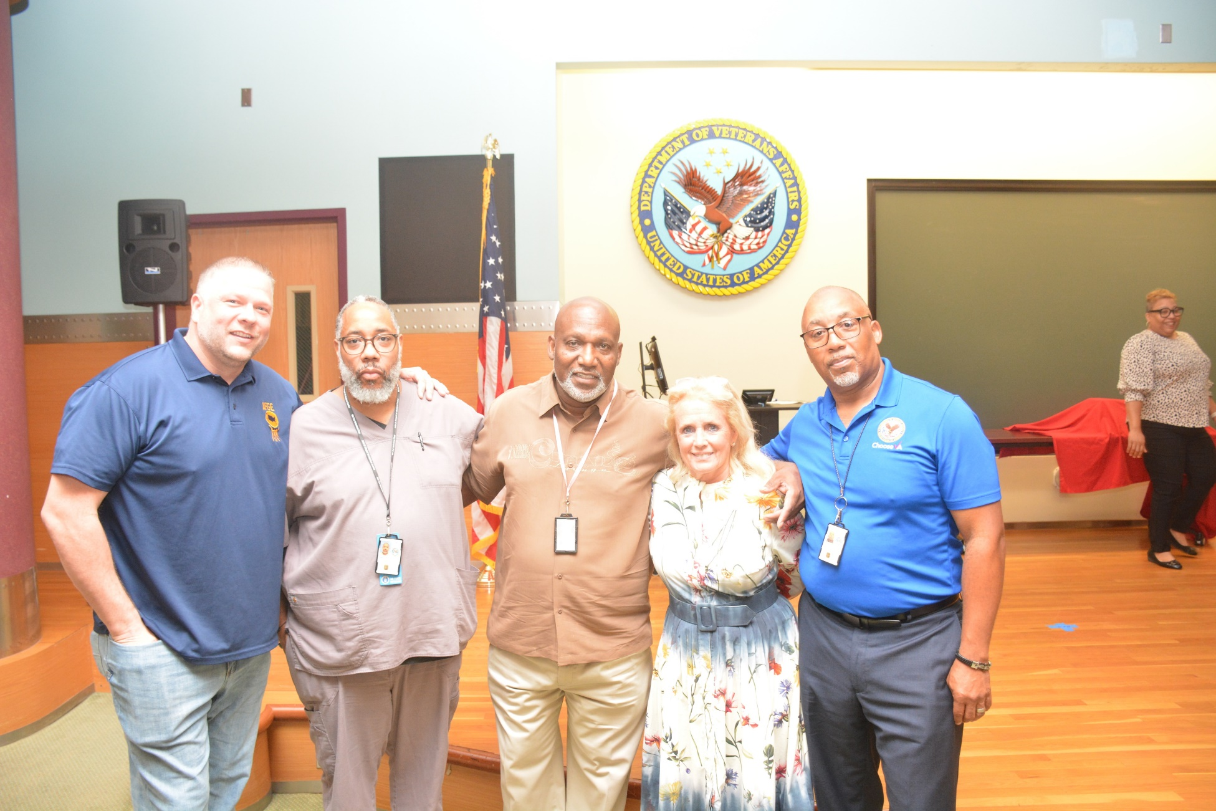
VETERAN APPRECIATION EVENT (Dingell VA – Detroit, MI)

Slide 21
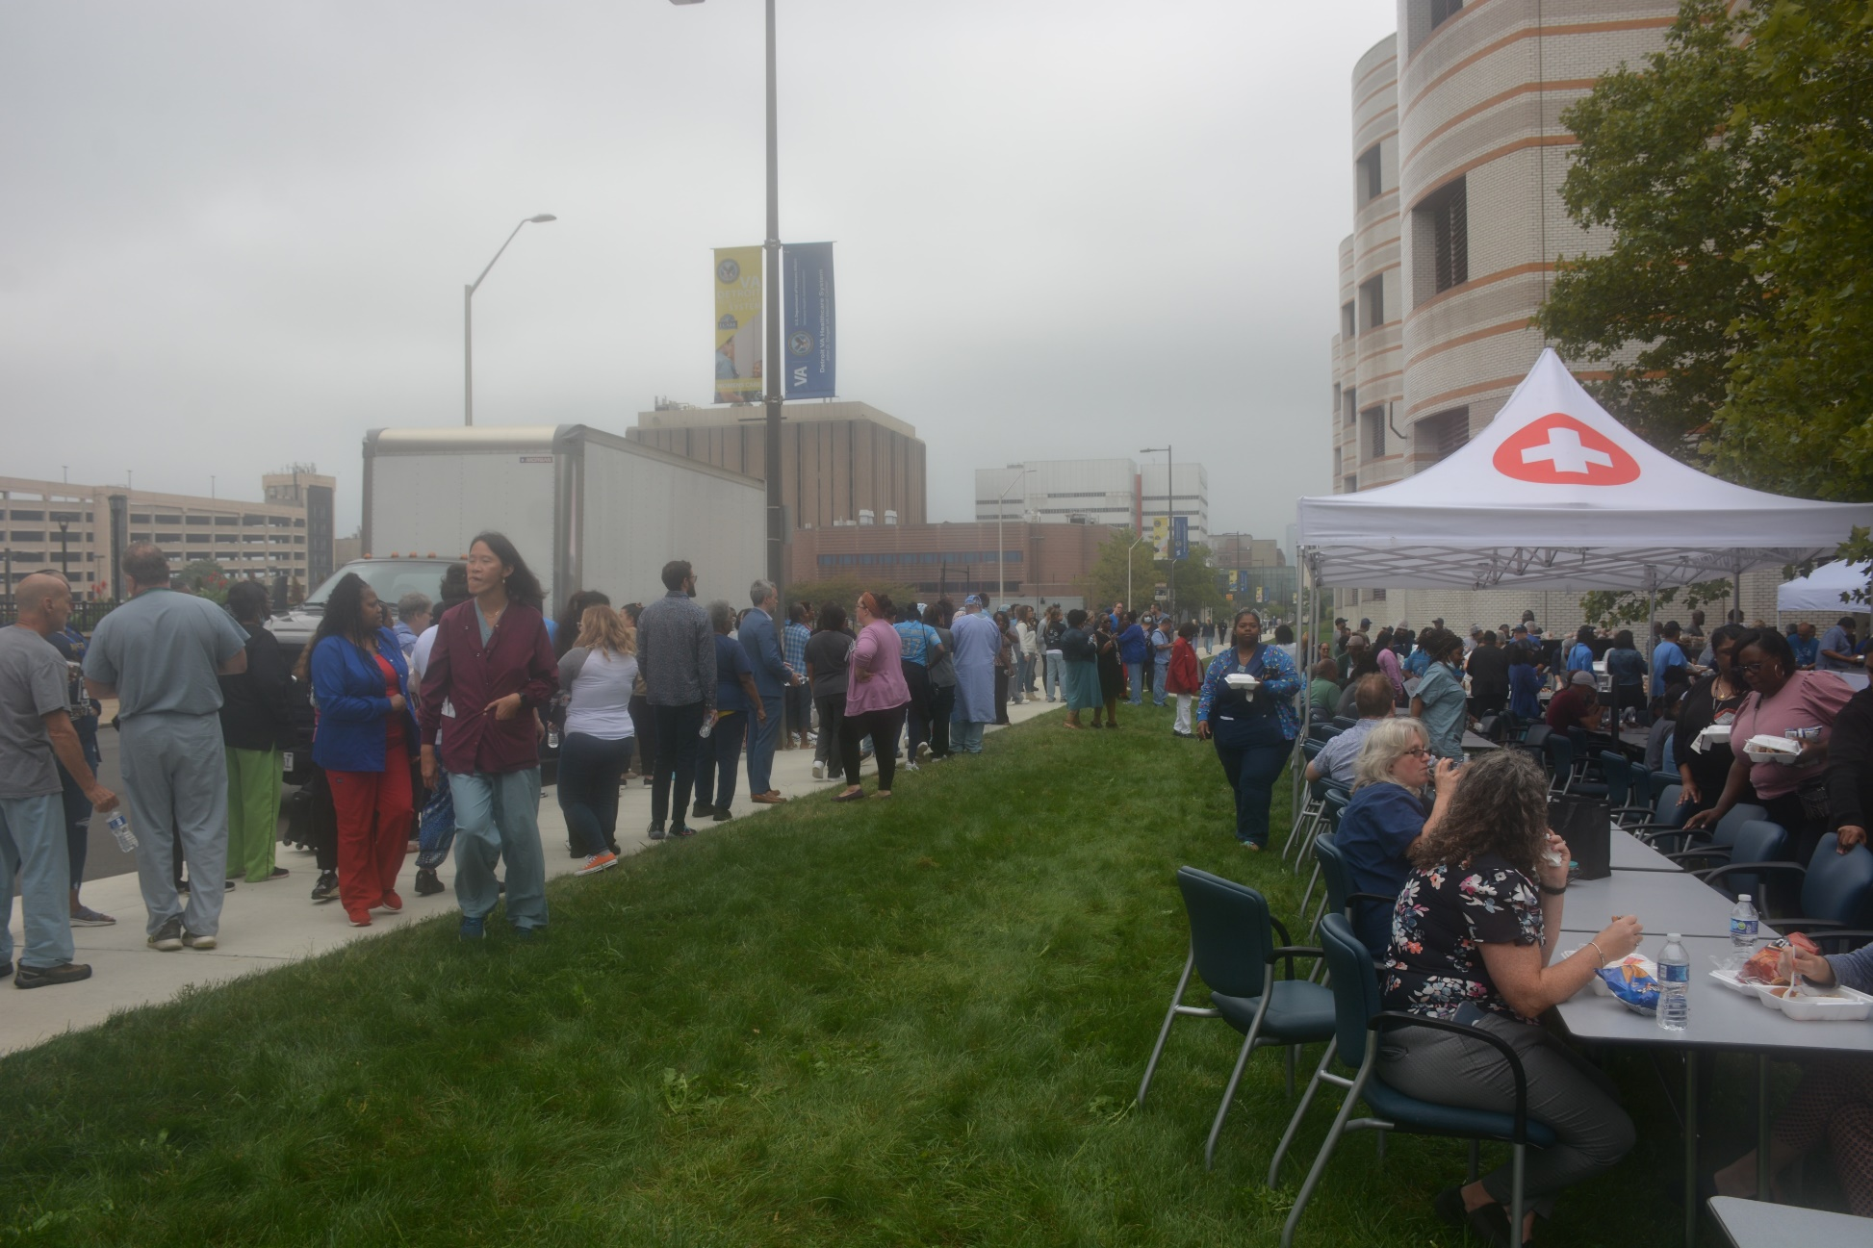
VETERAN APPRECIATION EVENT (Dingell VA – Detroit, MI)

Slide 22
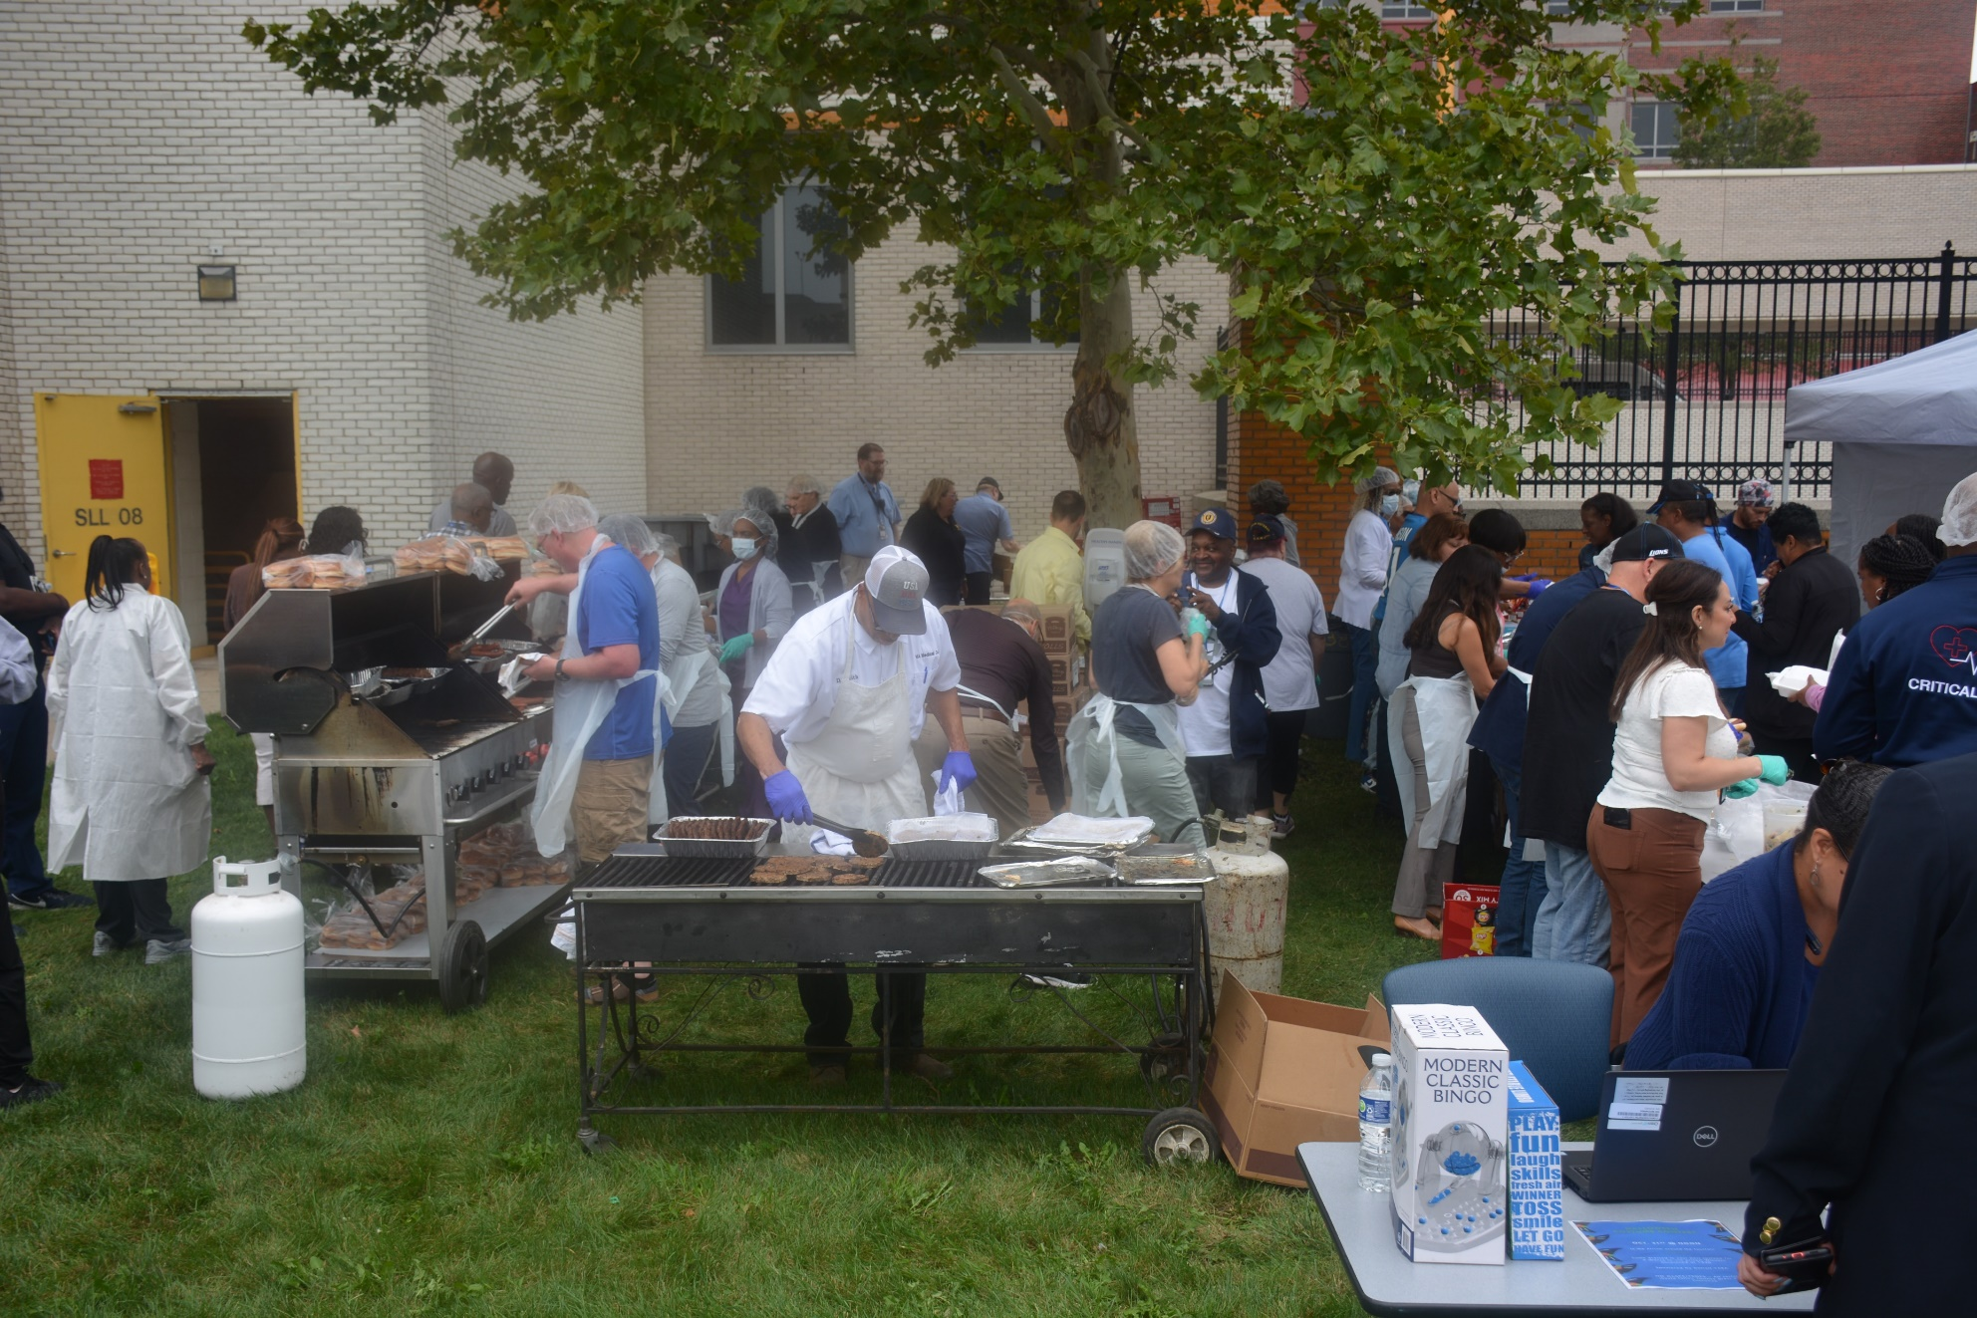
VETERAN APPRECIATION EVENT (Dingell VA – Detroit, MI)

Slide 23
DISTRICT VETERAN COORDINATORS

Slide 24
Questions

Slide 25
GO TO: WWW.AFGE.ORG/VETERANS

Slide 26
NEXT STEPS:
START A AFGE VETERANS COMMITTEE AT YOUR LOCAL BY APPOINTING VETERAN COORDINATORS.
MAKE A PLAN FOR LOCAL VETERAN ENGAGEMENT.
CARRY OUT ANNUAL VETERAN RECOGNITION EVENT
VOLUNTEER YOUR LOCAL TO DO A VETERANS BUILD PROJECT WITH HABITAT FOR HUMANITIES BY (31 Mar) EACH YEAR.

