Slide 1
Legislative Political Coordinator Breakfast
THIS INFORMATION CANNOT BE SHOWN AT WORK

Slide 2
Thank You!

Slide 3
Our 2015 Legislative Priorities
Federal Employees have already contributed over $150 Billion towards reducing the federal deficit-Enough is Enough!
Get a pay increase (FAIR Act)
Repeal or Delay the Sequester
Repeal pension contribution increases 2013/2014
Stop further pay cuts or pay freezes
Stop retirement contribution increase
Protect Dues Deduction
Protect Official Time
Council legislative priorities

Slide 4
How do we do this?

Slide 5
What are LPCs’ Duties?
Remain updated on legislative and political issues in the district and nationally
Meet with and contact by phone their member of Congress and Congressional Staff whenever needed
Stay connected with AFGE National Office and District staff
Work to increase PAC contributing in the Local
Participate in political events in support of AFGE endorsed candidates
Within two years of appointment as LPC, attend a Legislative and Political Training Institute (LPTI)

Slide 6
Your Hard Work Has an Impact
As of today, there are over 600named LPCs!
You and your members have made 14,817 calls
You and your members have sent 33,937 emails
You and your members have submitted 131 LTEs in 2014
You and your members have had countless local lobbying visits

Slide 7
Your Victories:
BPA Overtime Reform
Won Official Time-49 Republicans!
Part of TPA/TAA Fight-Still in limbo
TSP Fix for LEOs & Fire Fighters
VA Due process-Lost but we won
Still haven’t reintroduced Dues Deduction
580 LPCs
PAC is bigger then its ever been
LPTIs already executed in every District

Slide 8
Our Members Want Us Fighting for Them
Issues Revolving Around the Pocketbook
Inspire AFGE Members to Participate
Now, I'm going to read you a list of issues, and I'd like you to tell me which issue is most likely to compel you to participate in an AFGE-sponsored mobilization action.

Slide 9
Legislative and Political Mobilization Motivates Our Members:
Members Expect Union To Protect Their Retirement, Lobby For Their Interests, and Protect Them In The Workplace
% Rate 4-5
89
86
85
82
81
81
Now, I'm going to read you a list of issues, and I'd like you to tell me which issue is most likely to compel you to participate in an AFGE-sponsored mobilization action.

Slide 10
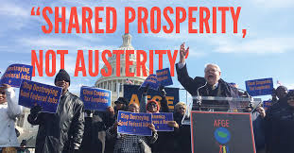
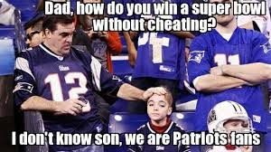
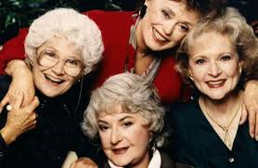
WE ARE A TEAM!

Slide 11
We are Here to Help!
Beth Moten, Legislative and Political Director
Bob Nicklas, Director Political Strategic Initiative
Tucker McDonald, Director Field Mobilization
Amy Lloyd, Deputy Director Field Mobilization
6 National Lobbyists
16 District and Agency Based Legislative Political Organizers (LPOs)
They are here for you. Please get to know them and answer their calls, emails, and texts. (http://www.afge.org/Index.cfm?page=LegislativePoliticalOrganizers)
And please reach out to your National Vice Presidents and Council leaders

Slide 12
AFGE did our fair share last election!

Slide 13
And Our Program Had an Impact:

Slide 14
So What is at Stake in 2016?

Slide 15
If One These Candidates are Elected President:
Bush-“We’re going to turn off the automatic switch of discretionary spending increases and weigh budgets only on its merits,” Bush said.
Walker-“The first step is, we’re going to deal with collective bargaining for all public-­employee unions,” Walker told a donor in a conversation captured in a 2011 documentary, “because you use divide-­and-conquer.”
Rubio-He is the author of the bill to eliminate dues process in the VA
Paul-offered an amendment in 2012 to eliminate automatic dues deduction for AFGE

Slide 16
To Protect Our Future, We Need More of 2 Things:

Slide 17
AFGE PAC:
Growth of AFGE PAC by election cycle:
2006 Cycle-AFGE raised $756,139
2008 Cycle-AFGE raised $1,063,601
2010 Cycle-AFGE-raised $1,154,500
2012 Cycle-AFGE-raised $1,138,714
2014 Cycle-AFGE raised $1,295,749

Slide 18
Automatic Progress in 2015:

Slide 19
By the end of the year….
2%

Slide 20
We Need You!

Slide 21
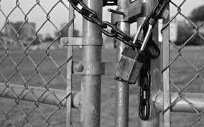
Shutdown/Lock Out Prep:
www.afge.org/Lockout
Probably Telephone Town Hall September 22nd
Get your Local ready
Reach out to your LPOs for any help

Slide 22
When You Get Back Home...
Sign up for texts/robo calls (text 225568 now)
After you answer the first three text questions, please text “LPC”
Sign up for Action Alerts with a personal email address
Check your home email
Be on telephone town halls
Use the patch through lines & send emails
Visit your Local Congressional office
Become a “Gimme” 5 contributor to PAC
Get others in your Local to become a “Gimme” 5 contributor to PAC
Attend LPTI
Use this LPC Dashboard https://www.afge.org/Index.cfm?Page=LPCDashboard
Get your coworkers involved in the fight and ask them to join AFGE!

Slide 23
Legislative Conference:
Dates for February 7-10th, 2016
We need you there. Please request your Local send you ASAP.

Slide 24
Again Thank you!

